Slide 1
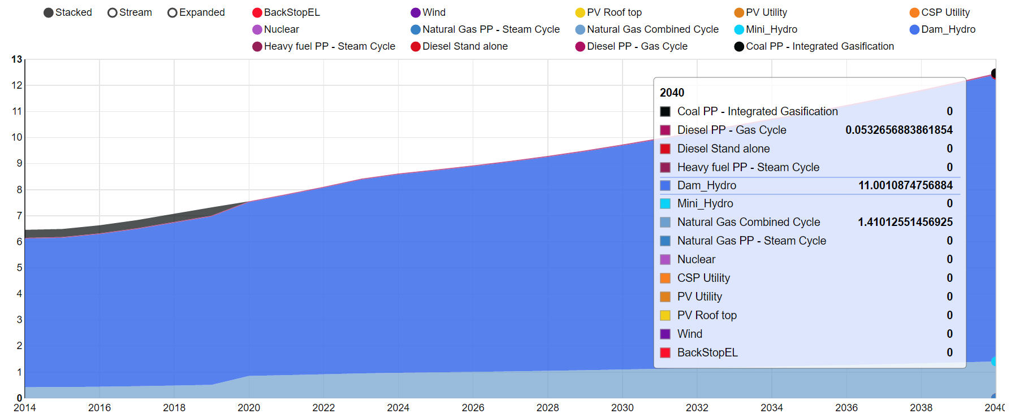
Representative OSeMOSYS results
Hydro and CCGT most competitive
Electricity Generation (PJ)
Initial capacity of COAL PP phased out at end of life
Year

Slide 2
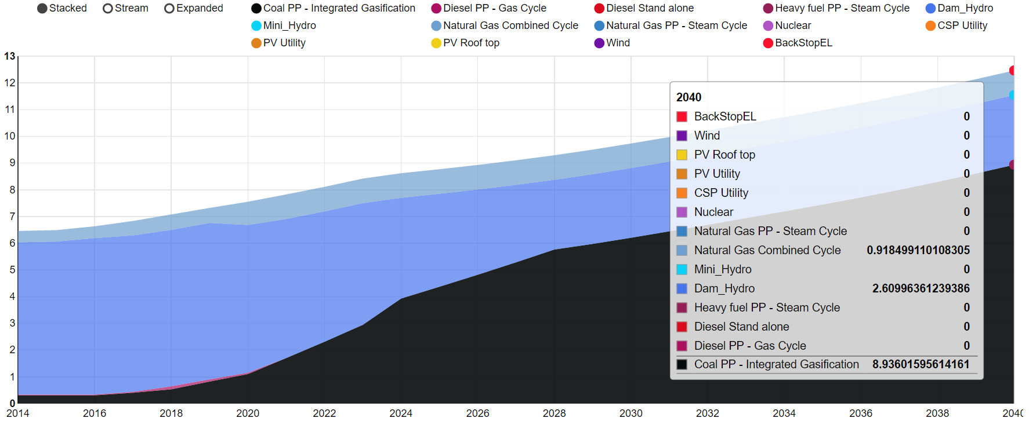
Representative OSeMOSYS results
What happens in a climate ‘water scarcity’ scenario?
Electricity Generation (PJ)
More generation from COAL PP, less reliance on HYDRO
Year

